Slide 1
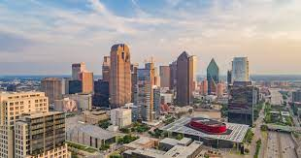
Most of my friends are like. Guys that i move to dallas with or you know we're friends in dallas. Friends at indiana

Slide 2

where i went to school or french. All my friends that i have been my friends my entire life for still my. Pause

Slide 3

amazing.

